Slide 1
Introduction to Intel Galileo
hadrihl // hadrihilmi@gmail.com

Slide 2
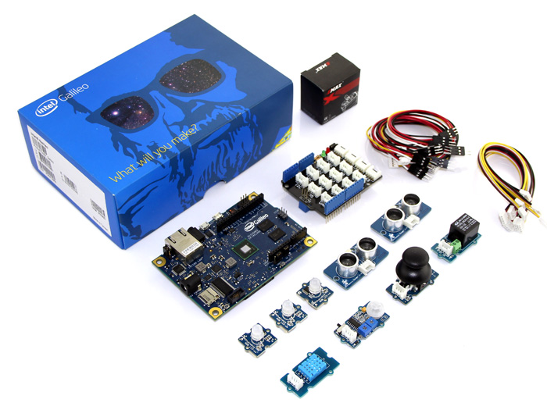
Intel Galileo - development boards based on Intel x86 architecture and is designed for the maker and education communities.
CPU: Intel Quark X1000 400MHz
Operating System: Linux
Memory: 256Mb
Storage: Micro SD Slot
Mini PCI Expres: possible for WiFi, GPS, Bluetooth
Ethernet ready
Arduino compatible: hardware and software

Slide 3
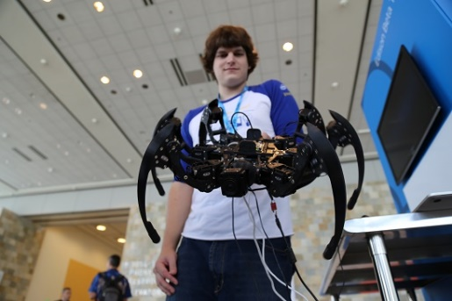

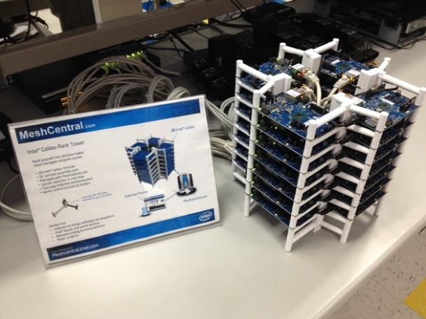


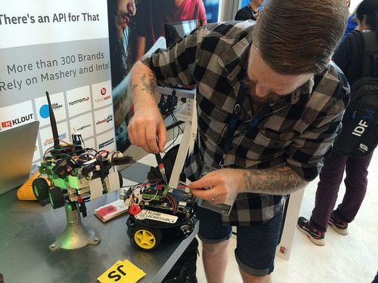

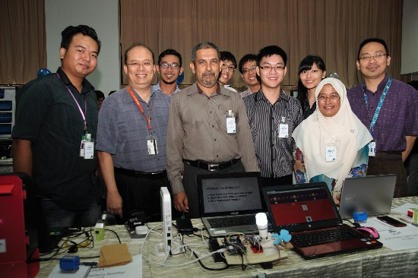
What’s actually happening?

Slide 4


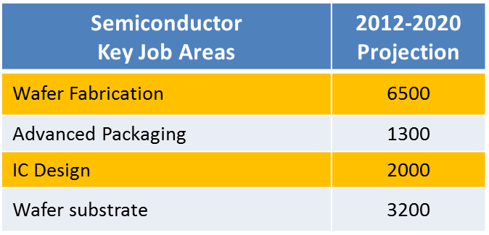


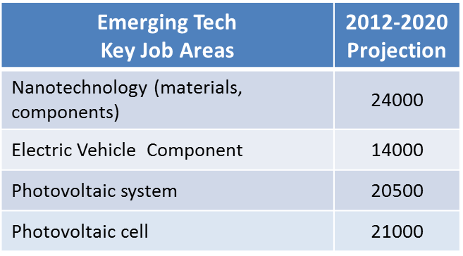
E&E Jobs Demand 2012-2020
Notes:
Embedded system – job demand

